Slide 1


Department of Computer Science and Engineering
DATA SCIENCE
Session: 2025-26
TITLE OF PROJECT:
Indian Crop Cost & Profitability Analysis Dashboard
Presented By:
Name: Ruthvek Kannan
PRN: 22070521031
Institute Mentor:
Name: Dr. Piyush Chauhan
Symbiosis Institute of Technology, Nagpur Campus (SIT-N)

Slide 2
Table of Contents
Introduction & Problem Statement……………………………………………………………………………………………………………………….…..….……1
The Solution: An Interactive Dashboard………………………………………………………………………………………………………………….…………..2
Exploratory Data Analysis (EDA)..……………………………………………………………………………………………………………………….…………..3
Data Distribution
Cost Variations
Yield & Profitability
Profitability Trends
Correlation Analysis
Model Performance Evaluation………………………………………………………………………………………………………………………………………8
Overview
Regression Models
Classification Models
Clustering Models
Prediction Tool………………………………………………….……………………………………..……………………………………………………………15
Advanced Features………………………………………………………………………………………………………………………………………………….16
What-If Scenario Analysis
Profitability Calculator

Slide 3
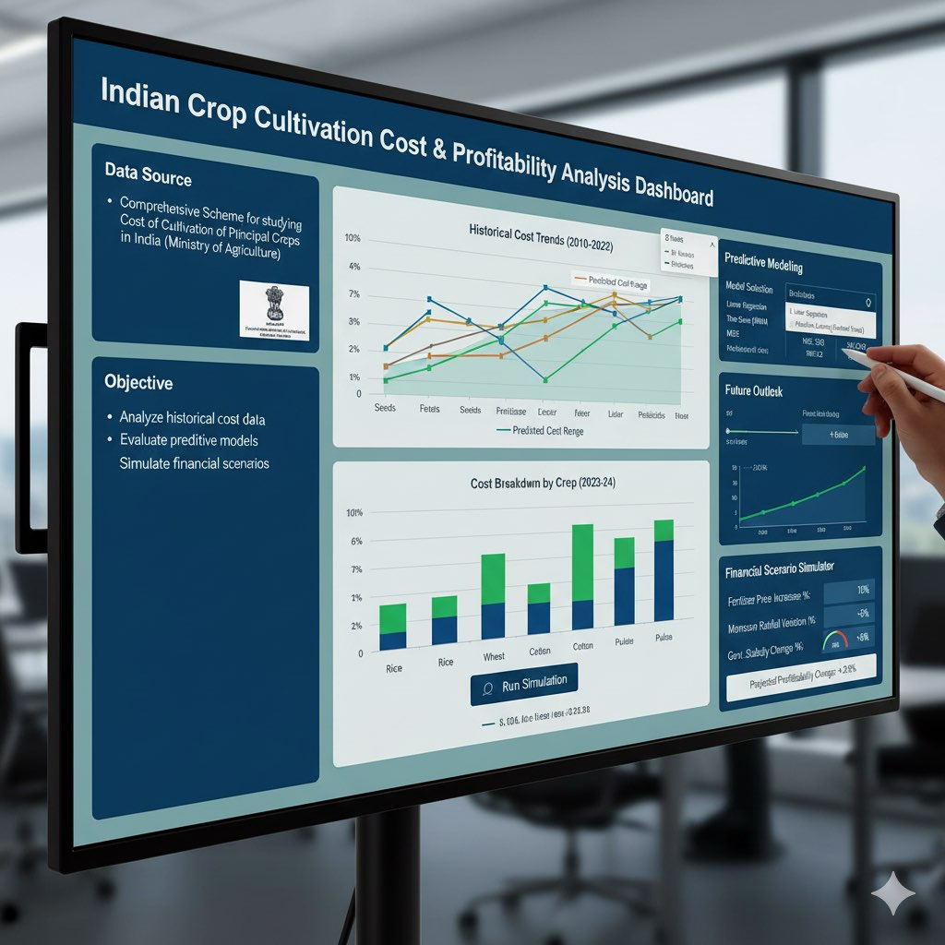
Introduction & Problem Statement
1
Agriculture is a critical sector in India, but profitability is often challenged by fluctuating cultivation costs.
Understanding the drivers of these costs and predicting future expenses is vital for farmers, policymakers, and analysts.
Goal: To develop an interactive dashboard for analyzing historical cost data, evaluating predictive models, and simulating financial scenarios related to crop cultivation in India.
Data Source: Comprehensive Scheme for studying Cost of Cultivation of Principal Crops in India (Ministry of Agriculture).

Slide 4
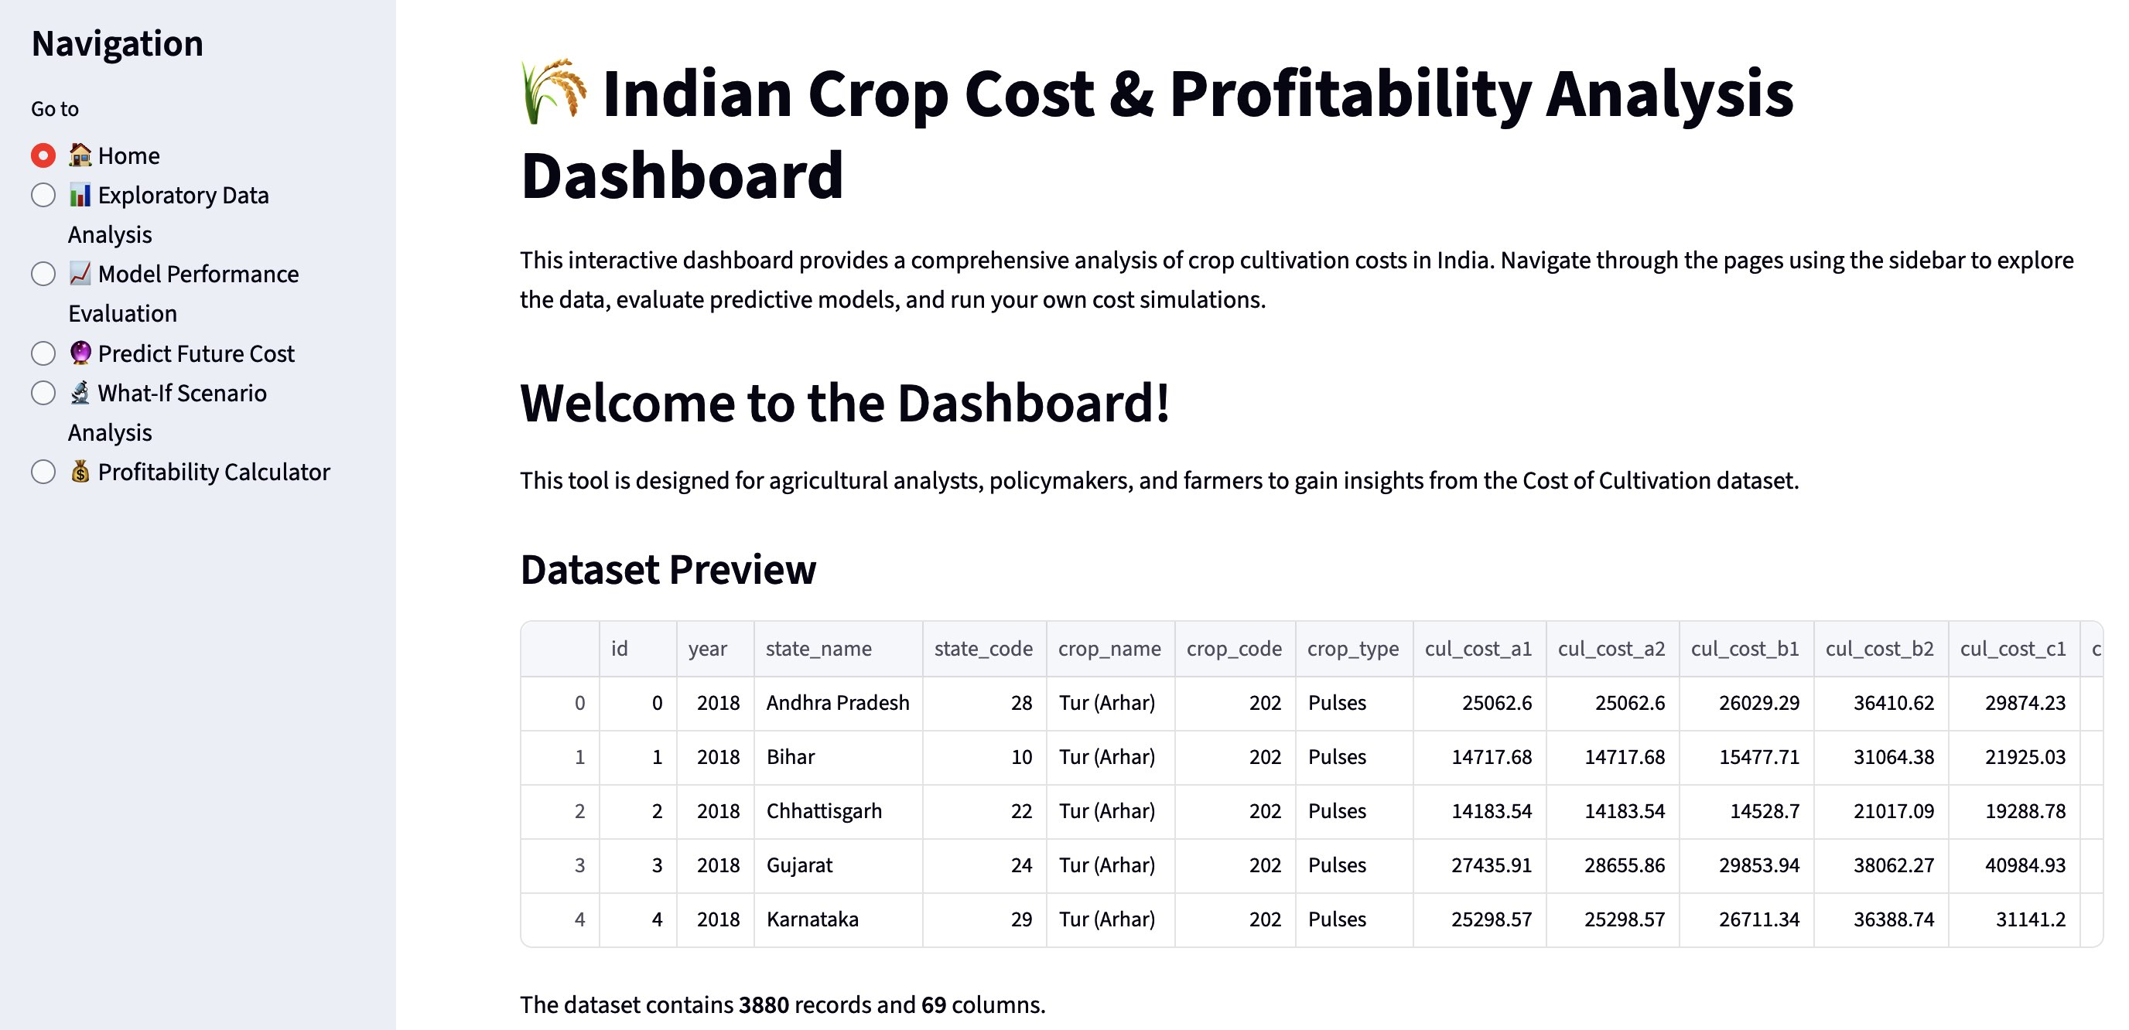
The Solution: An Interactive Dashboard
2
We developed an interactive web application using Streamlit to explore and analyze the crop cost dataset.
The dashboard provides several key functionalities accessible via the sidebar:1)Exploratory Data Analysis (EDA) 2)Model Performance Evaluation 3)Future Cost Prediction 4)What-If Scenario Analysis 5)Profitability Calculator

Slide 5
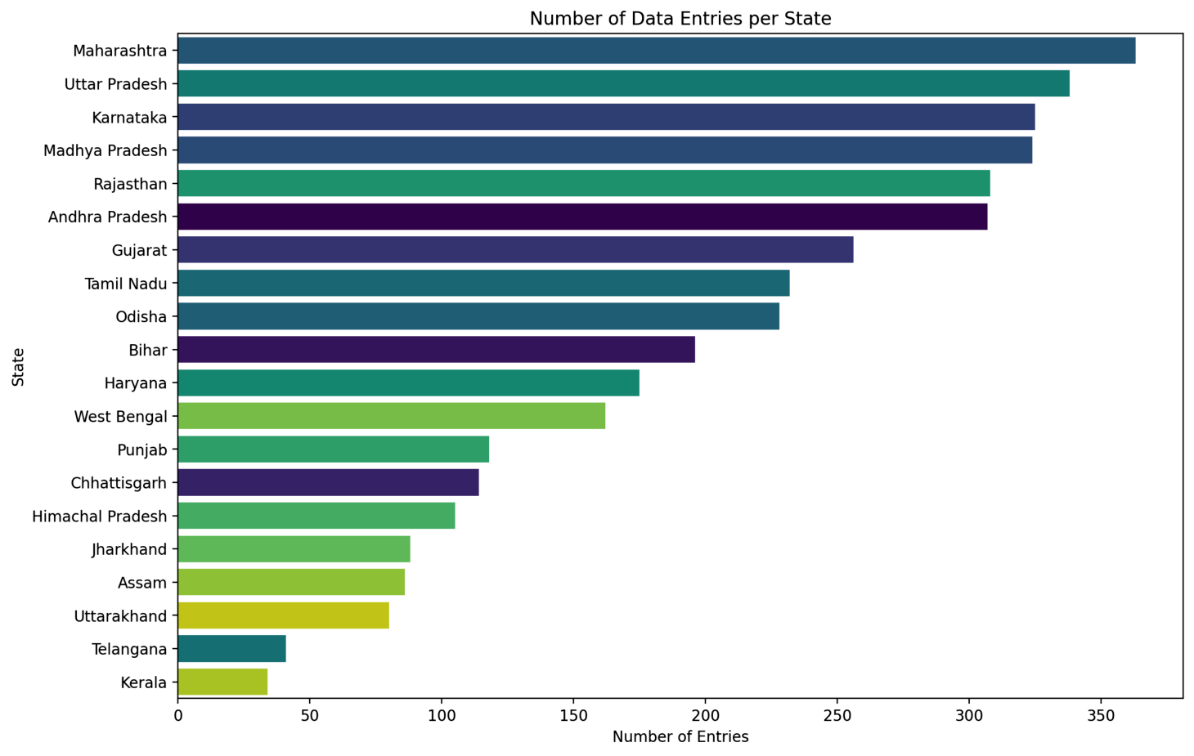
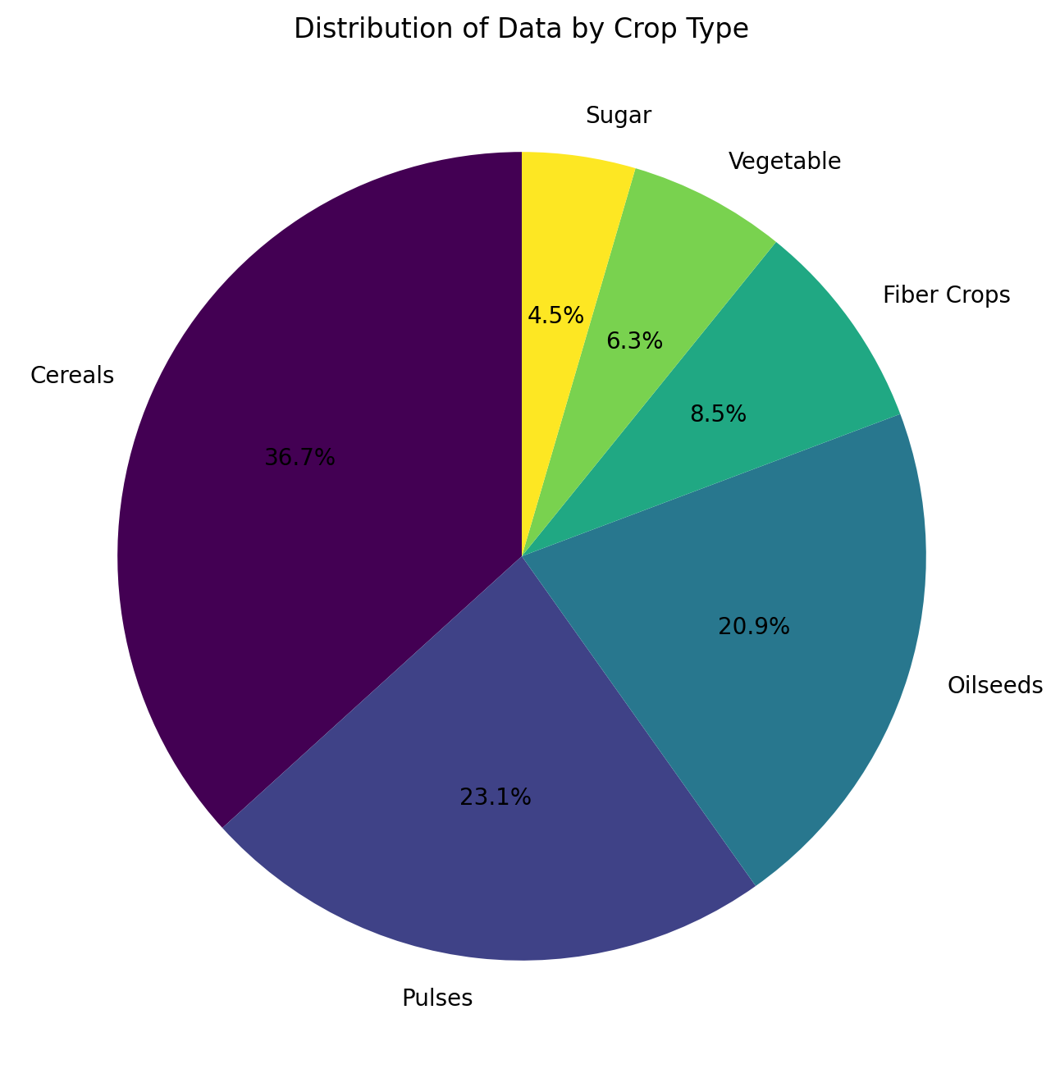
Exploratory Data Analysis (EDA) - Data Distribution
3
We generated various visualizations to explore distributions, relationships, and regional variations in costs, yields, and profitability.
Geographic Spread:Data collection is spread across numerous states, with the highest number of entries from Maharashtra, Uttar Pradesh and Karnataka
Crop Types:The dataset has significant representation for Cereals (36.7%), Pulses (23.1%), and Oilseeds (20.9%).

Slide 6
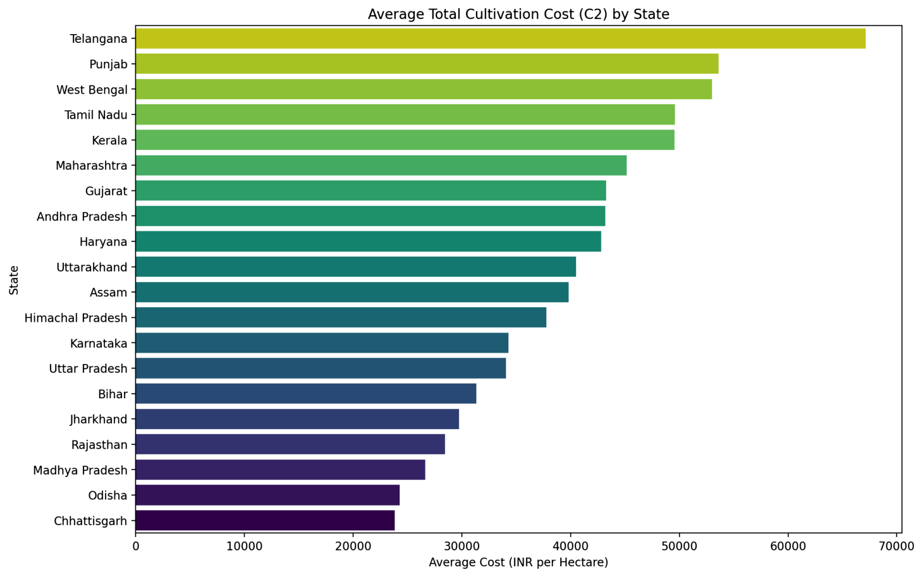
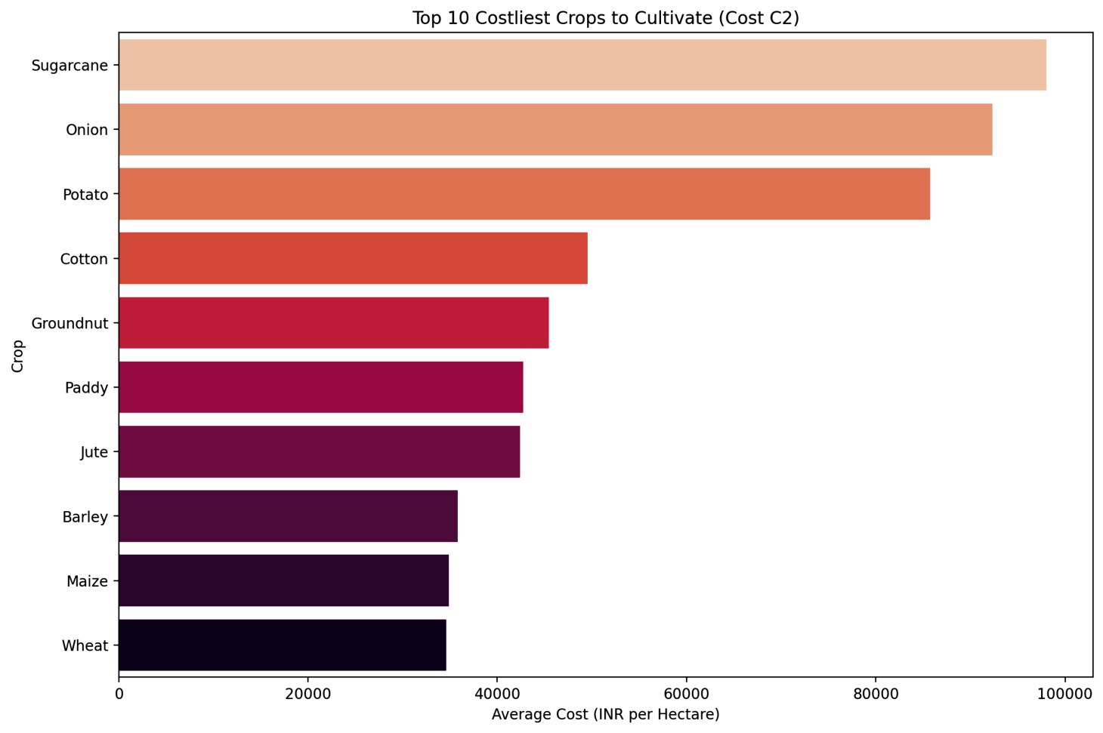
EDA - Cost Variations
4
Regional Costs: Cultivation costs vary significantly by state. Telangana shows the highest average cost (Approx. ₹67,000)while Chhattisgarh shows the lowest (Approx. ₹24,000).
Certain crops are inherently more expensive to cultivate. Sugarcane (Avg. ₹98,000) and Onion (Avg. ₹85,000) top the list.

Slide 7
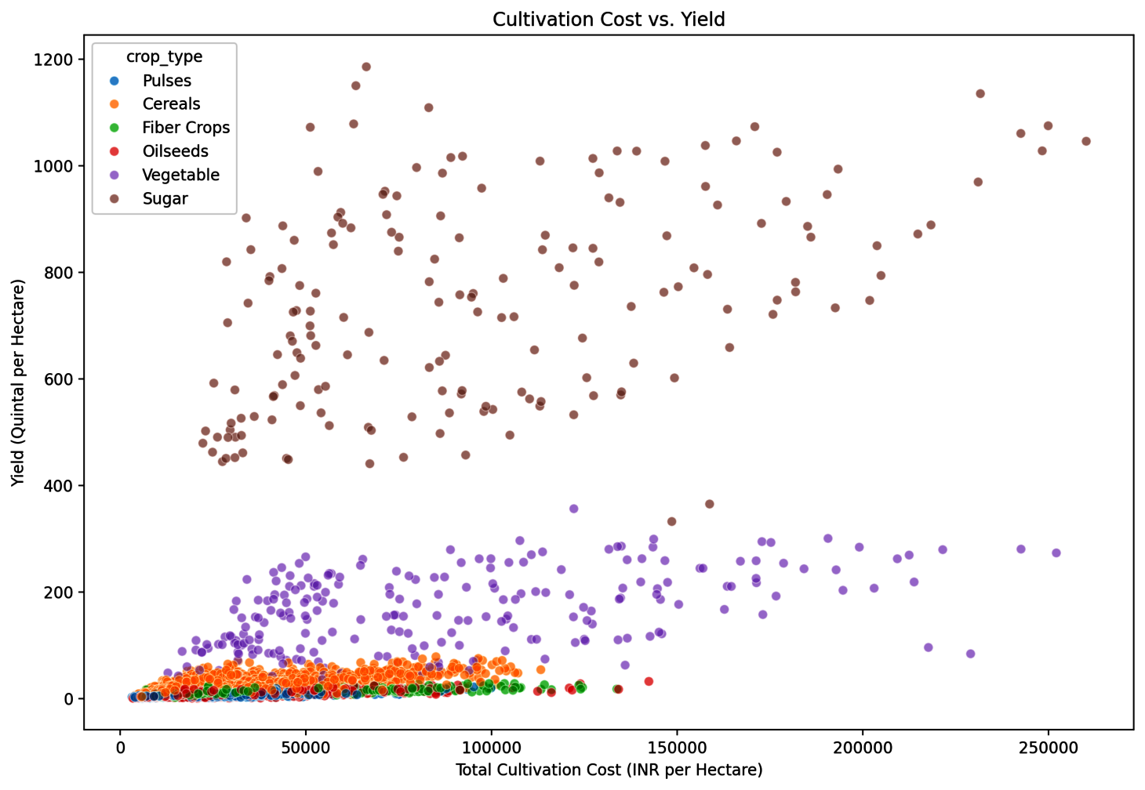
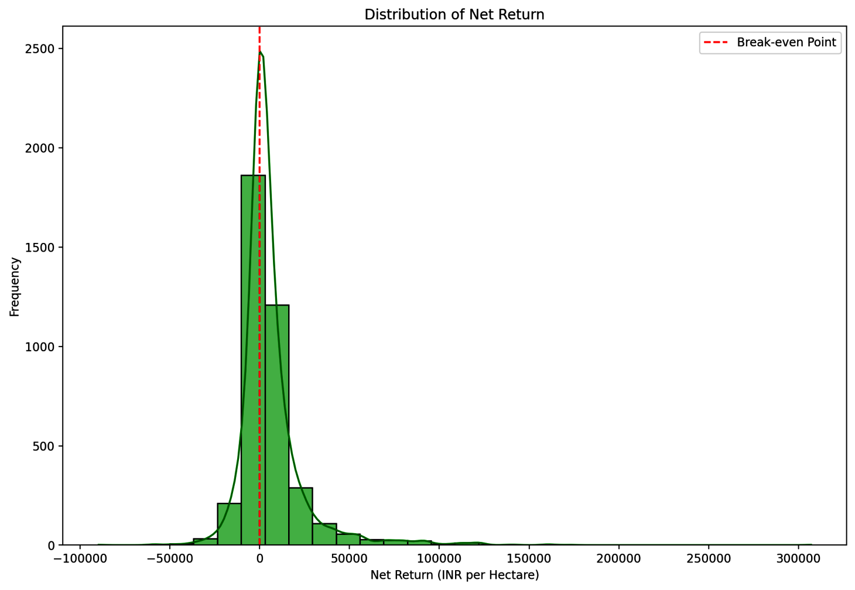
EDA - Yield and Profitability
5
Cost vs. Yield: Generally, higher costs are associated with higher yields, but there's significant variance, suggesting differing levels of efficiency among farming operations.
Profitability: The Net Return distribution shows that while many operations are profitable (right of the red line), a substantial number operate at a loss (left of the red line).

Slide 8
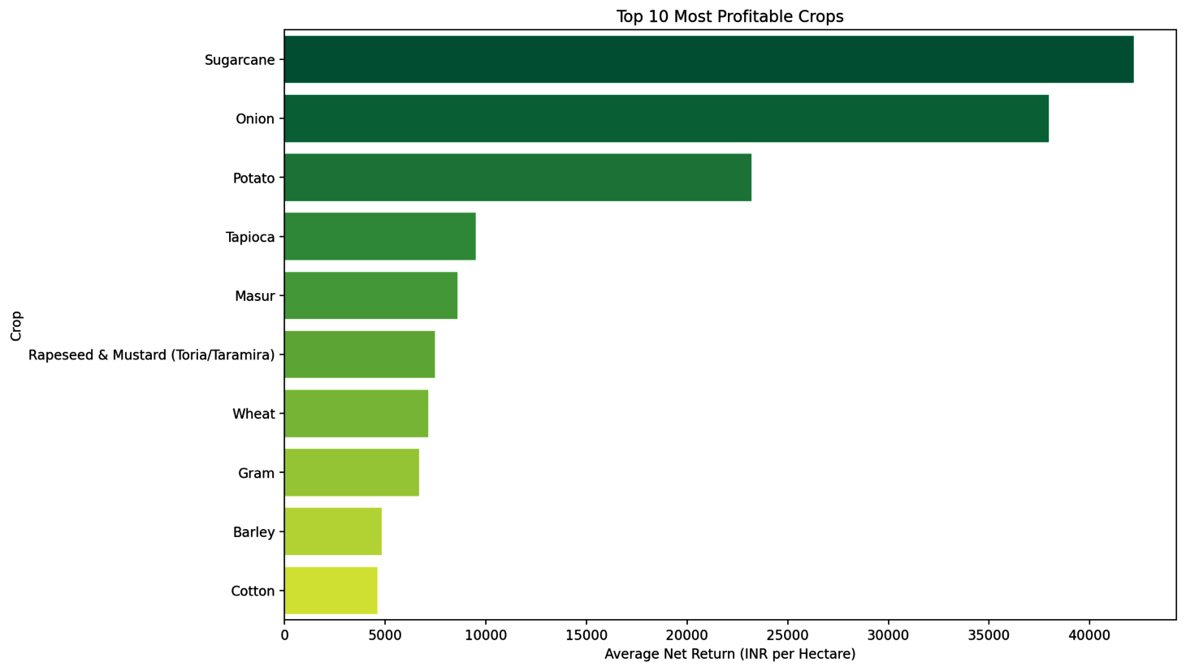
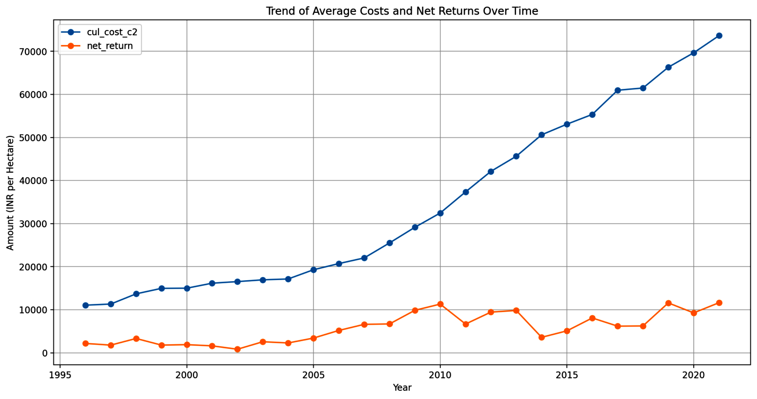
EDA - Profitability Trends
6
Most Profitable Crops: Crops like Sugarcane (Avg. Net Return:₹45,000) and Onion (Avg. Net Return:₹37,000) show the highest average profitability.
Cost-Price Squeeze: Over time, average cultivation costs have risen steadily, while average net returns have been much more volatile and haven't shown a similar upward trend, highlighting potential profitability challenges.

Slide 9
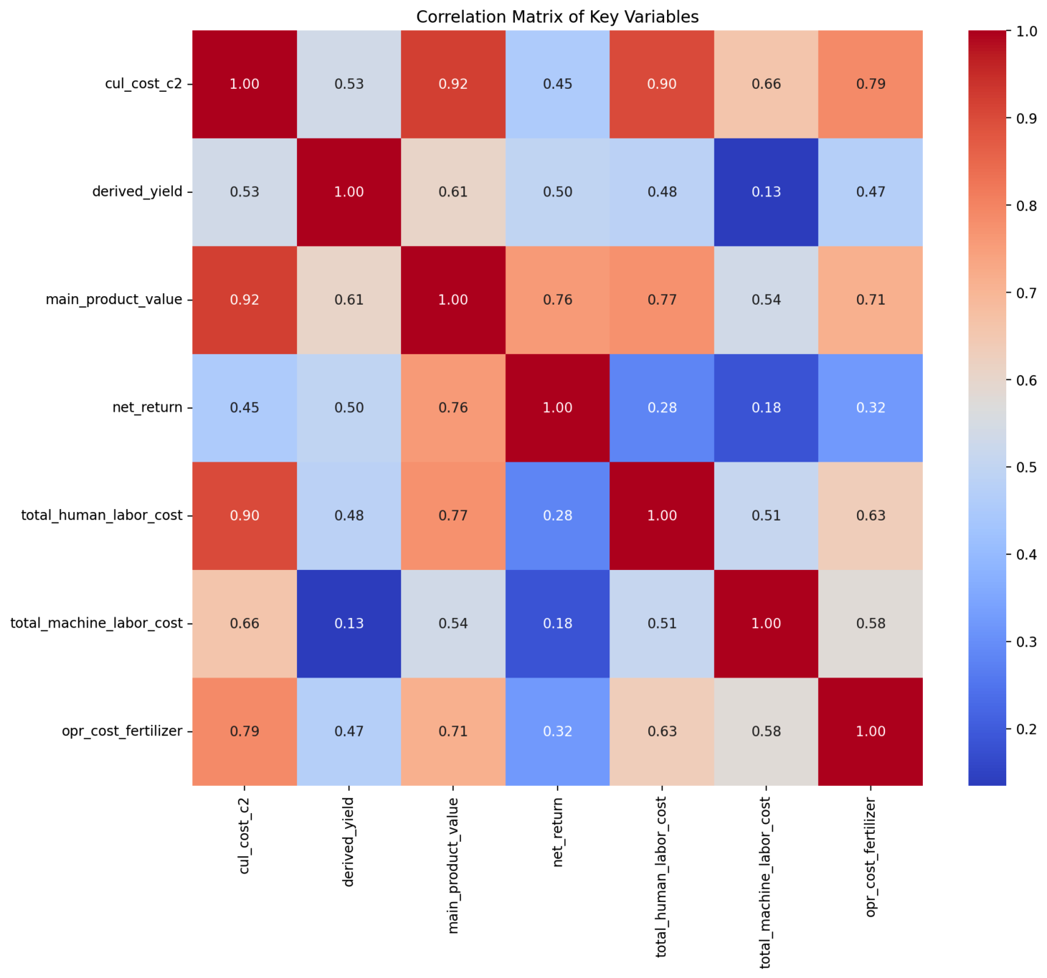
EDA - Correlation Analysis
7
The correlation matrix reveals expected relationships:
Strong positive correlation between cultivation cost (cul_cost_c2) and key inputs like labor and fertilizer.
Positive correlation between yield (derived_yield) and revenue (main_product_value).
Understanding these correlations is vital for building effective predictive models.

Slide 10
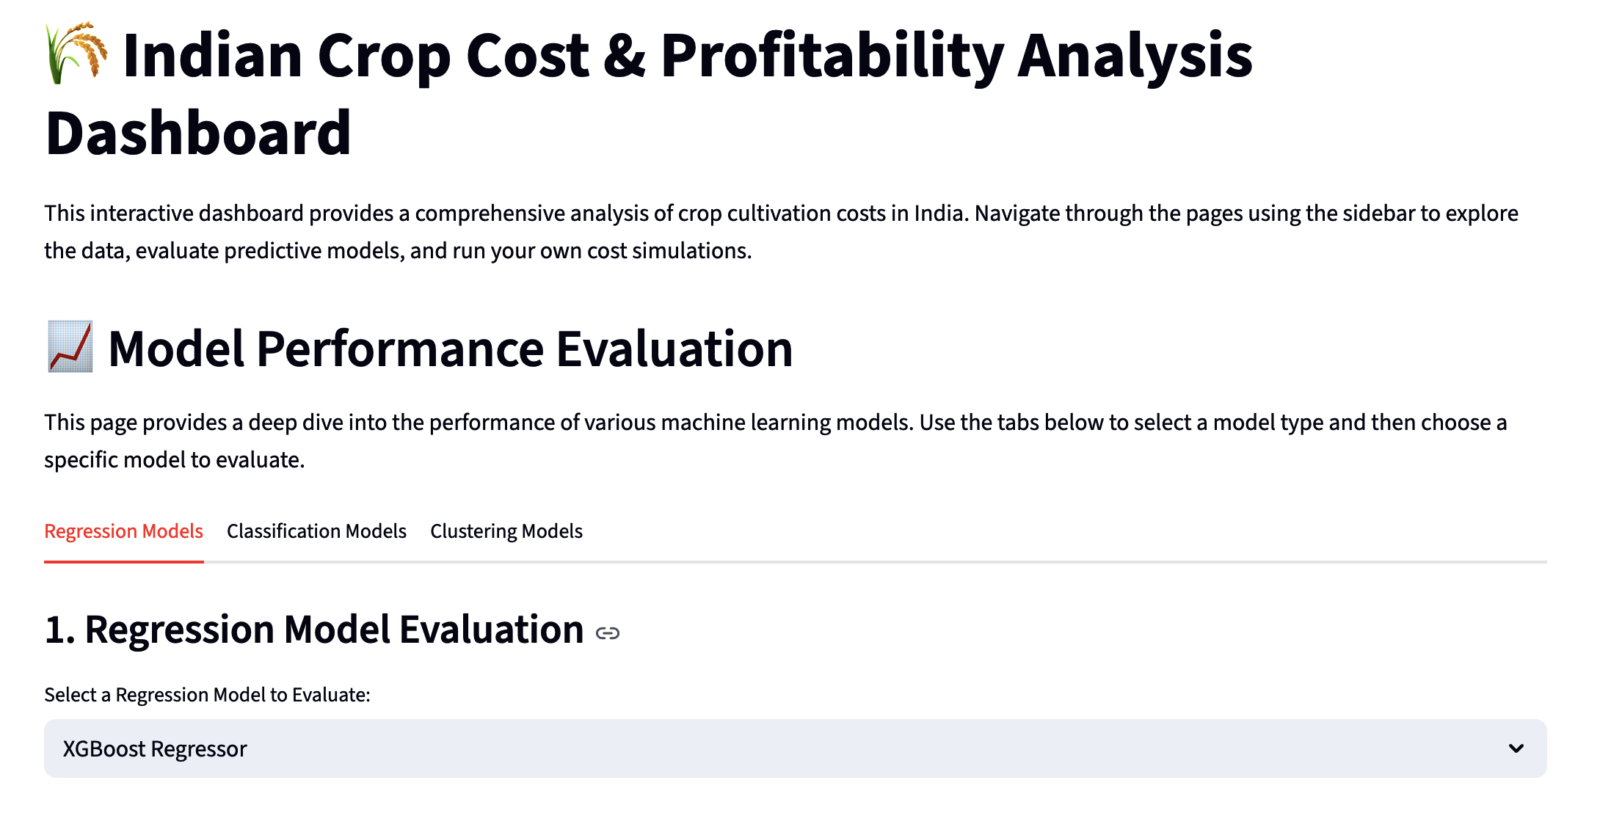
Model Performance Evaluation
8
We evaluated machine learning models for three distinct tasks:
Regression: Predicting the exact production cost per quintal (prod_cost_c2).
Classification: Predicting the cost efficiency category (e.g., Lowest Cost, Highest Cost) relative to peers growing the same crop.
Clustering: Discovering natural groupings or archetypes of farming operations based on their characteristics.
Regression Models
We assessed multiple algorithms for each task to identify the best performers.

Slide 11
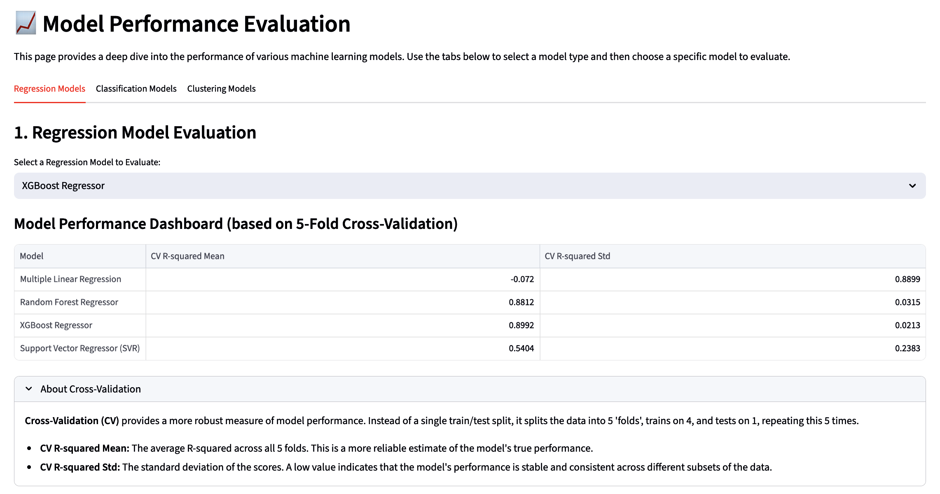
Regression Models - Performance Dashboard
9
Goal: Predict the production cost per quintal (prod_cost_c2).
Features Used:state_name, crop_name, year, derived_yield, opr_cost_seed, opr_cost_fertilizer, total_human_labor_cost, total_machine_labor_cost.
Evaluation Approach: Used 5-Fold Cross-Validation to get a reliable estimate of performance (Mean R-squared).
Initial Findings: The dashboard compares [List Models Evaluated, e.g., XGBoost, Random Forest, SVR, Linear Regression]. Based on Mean CV R-squared, XGBoost shows the strongest performance (Mean R² =0.89)

Slide 12
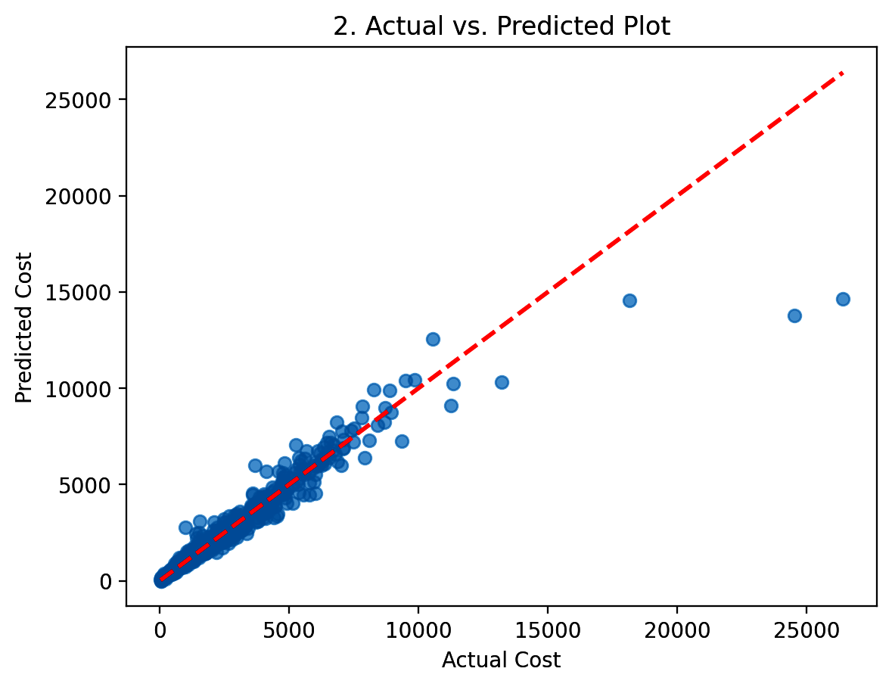
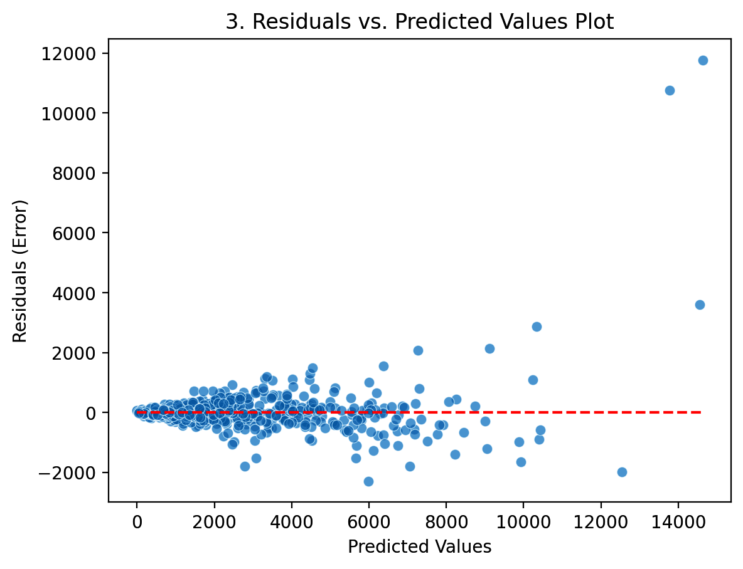
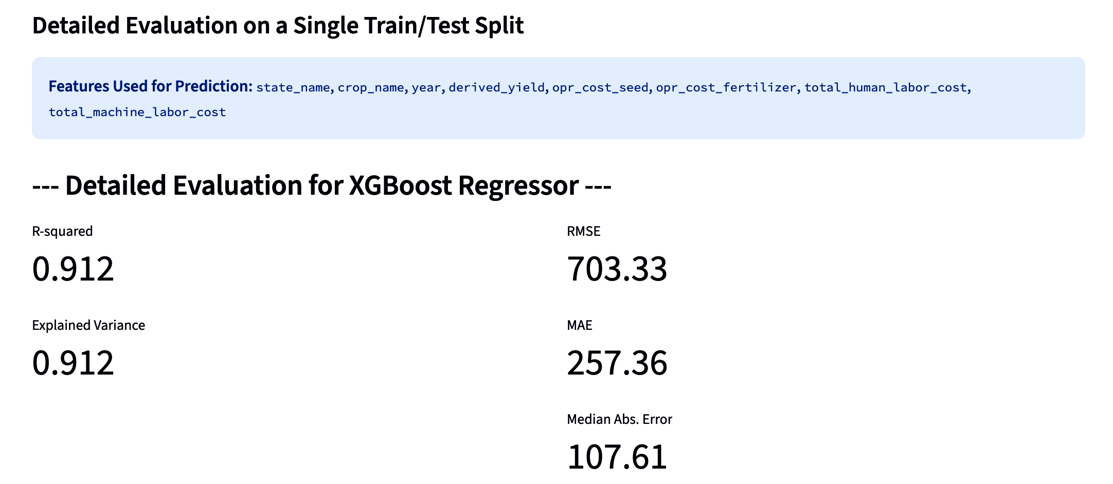
Regression Models - Detailed Look (Best Model-XG BOOST)
10
Performance on Test Split:
R-squared / Adj. R-squared: 0.912 (Meaning 0.912 % of cost variation is explained).
RMSE: 703.33 (Average error magnitude, penalizing large errors).
MAE: 257.36 (Average absolute error in Rupees).
Explained Variance: 0.912 (Closer to 1 is better).
Median Absolute Error: 107.61 (Error robust to outliers).
Actual vs. Predicted: Points cluster reasonably well around the ideal line.
Residuals Plot: Shows [Describe pattern, e.g., mostly random scatter around zero, suggesting low bias].

Slide 13
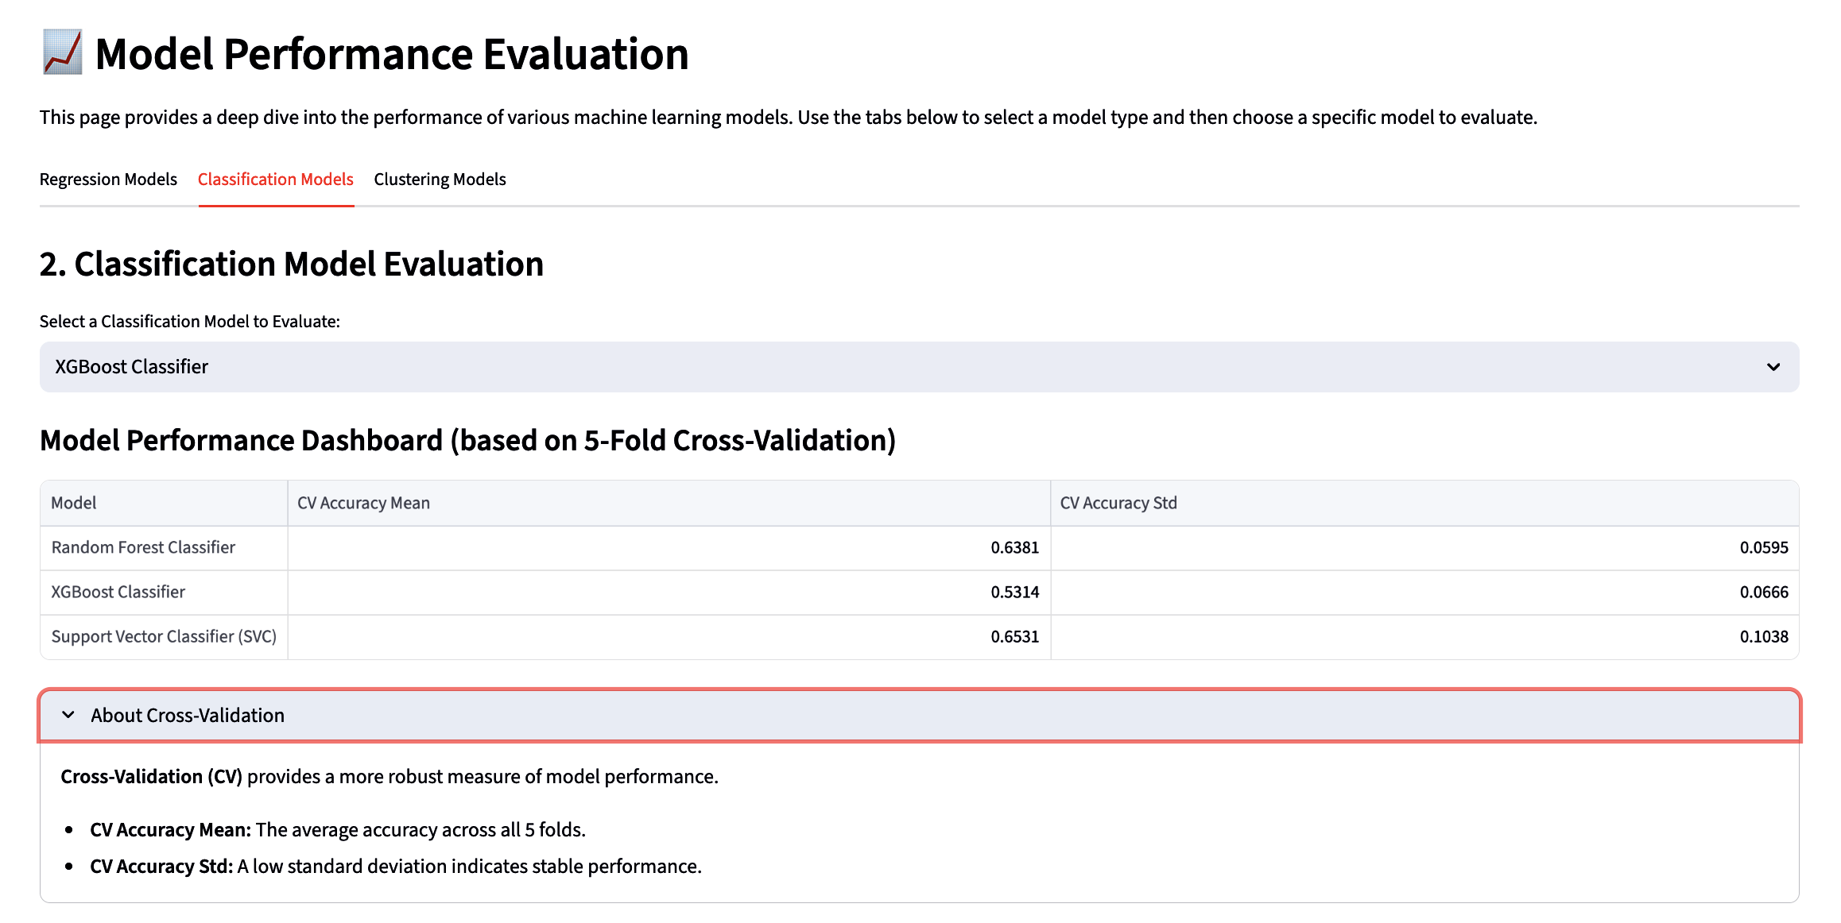
Classification Models - Performance Dashboard
11
Goal: Classify farms into cost efficiency groups (Lowest, Below Avg, Above Avg, Highest) relative to other farms growing the same crop.
Features Used: state_name, crop_name, year, derived_yield, opr_cost_seed, opr_cost_fertilizer, total_human_labor_cost, total_machine_labor_cost.
Evaluation Approach: Used 5-Fold Cross-Validation (Mean Accuracy).
Initial Findings: Comparing [List Models, e.g., XGBoost, Random Forest, SVC]. Support Vector Classifier (SVC) achieves the highest average accuracy (Mean Accuracy = 0.65.%)

Slide 14
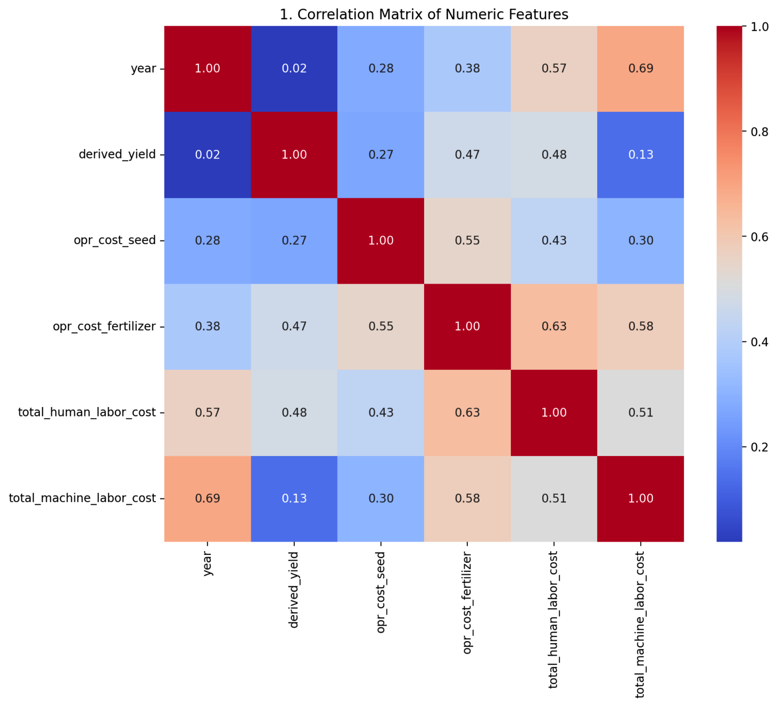
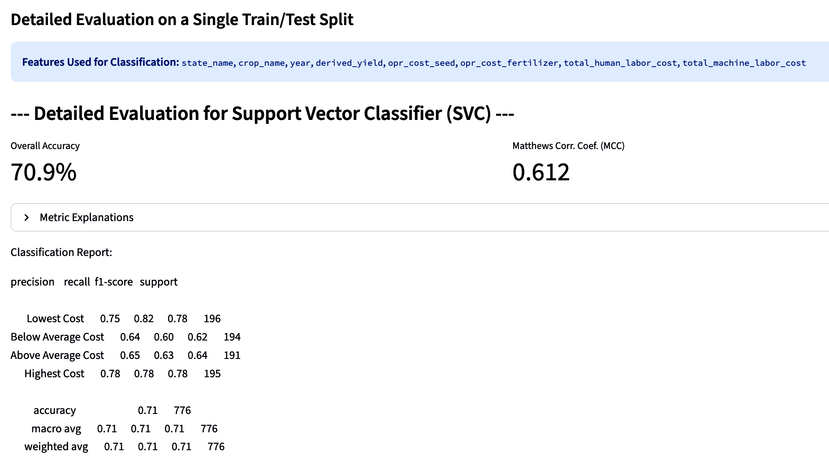
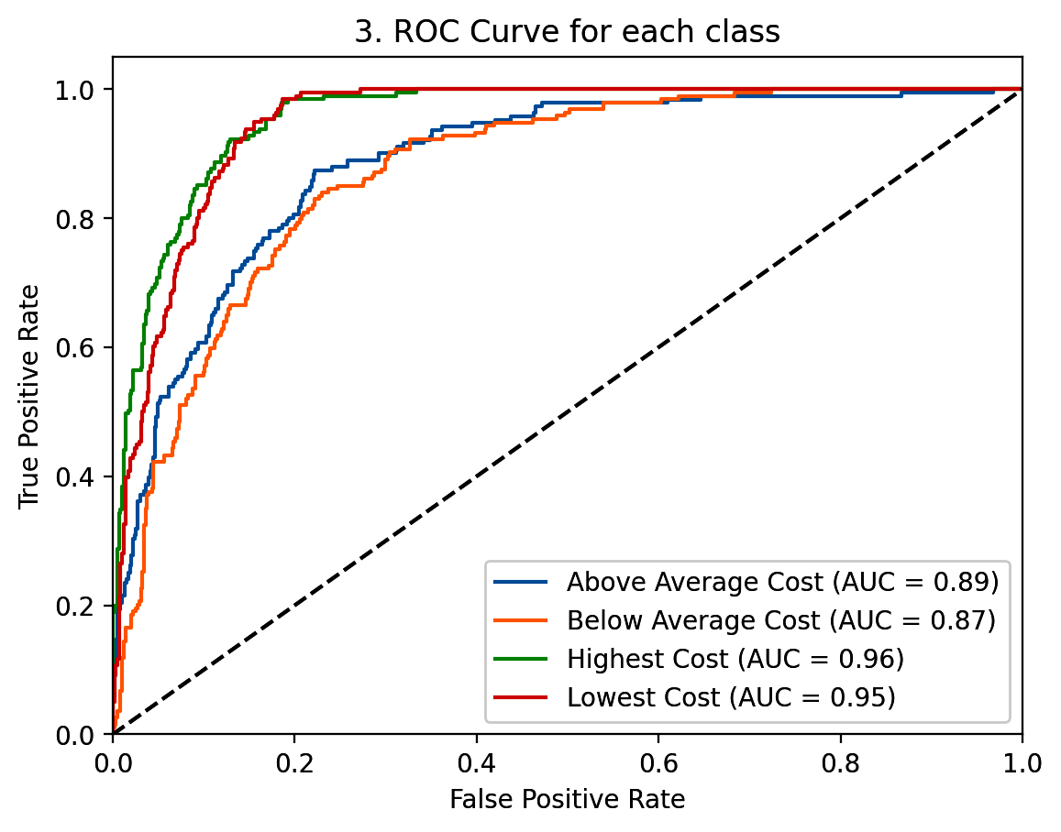
Classification Models - Detailed Look (Best Model-SVC)
12
Performance on Test Split:
Overall Accuracy: 70.9% (Percentage correctly classified).
MCC: 0.612 (Balanced measure, closer to 1 is better).
Classification Report: Shows Precision, Recall, F1-score for each class. The model performs worst on the Below Average Cost category.
ROC Curve: AUC scores range from 0.89 to 0.95 across classes, indicating [Good/Fair] discrimination ability.
Confusion Matrix: Shows most confusion occurs between total_machine_labor_cost and year.

Slide 15
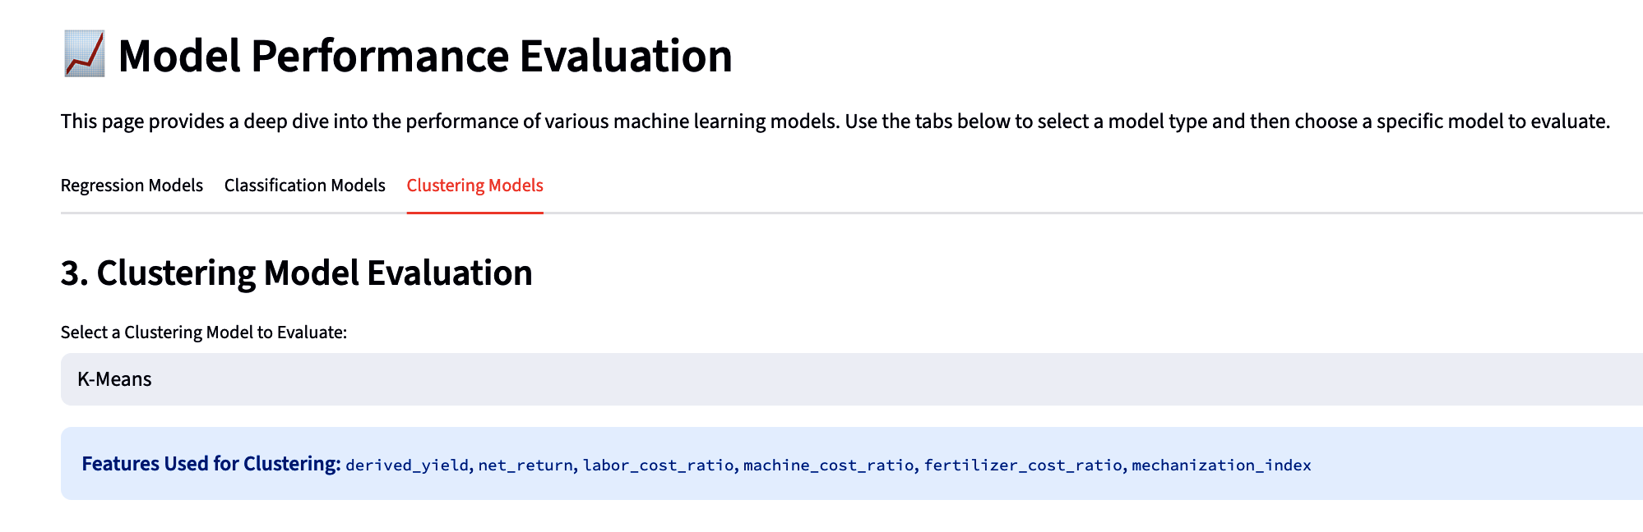
Clustering Models - Discovering Farm Archetypes
13
Goal: Unsupervised learning to identify natural groupings (clusters) of farms based on operational characteristics, without predefined labels.
Features Used: derived_yield, net_return, labor_cost_ratio, machine_cost_ratio, fertilizer_cost_ratio, mechanization_index. (These are ratio-based to focus on structure, not just scale).
Algorithms Explored: K-Means, DBSCAN, Agglomerative Clustering.

Slide 16
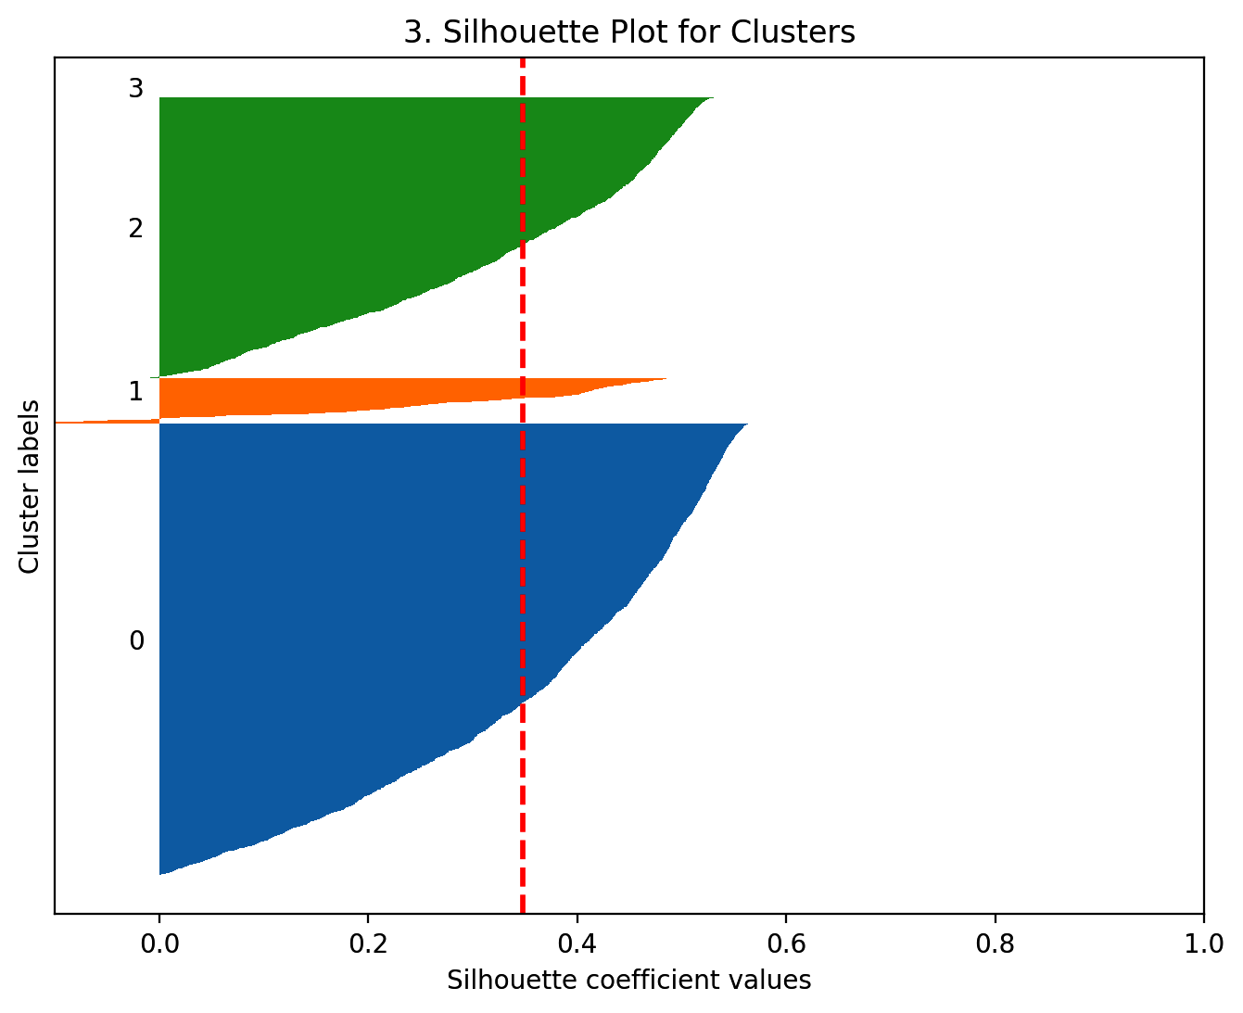
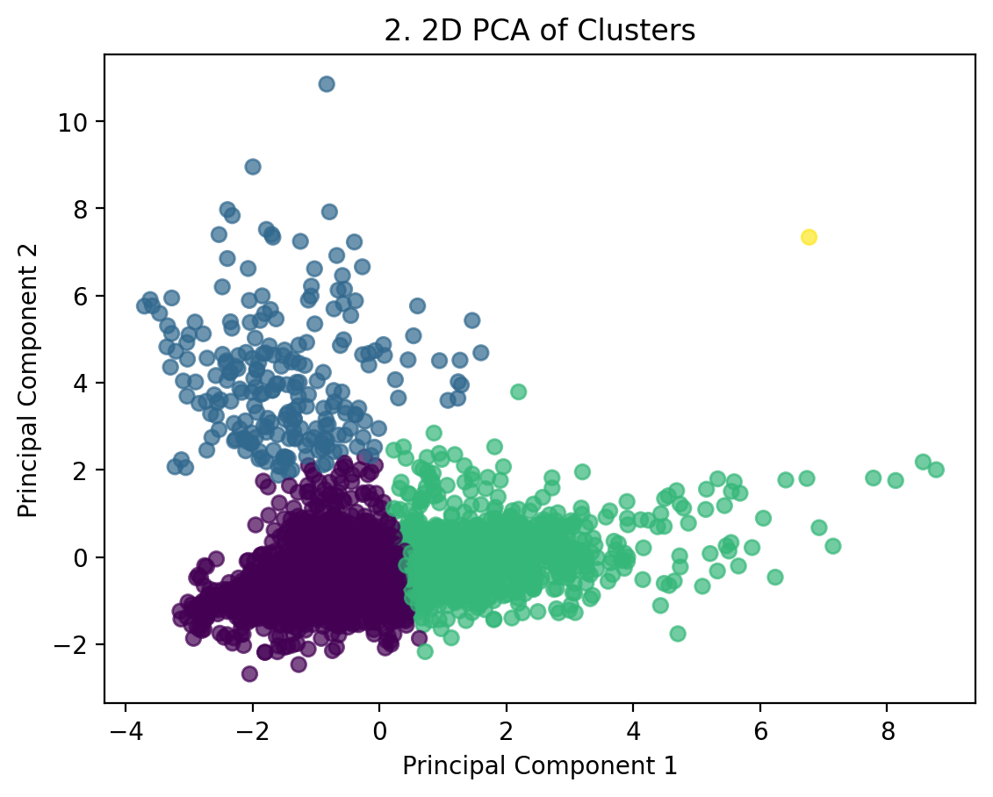
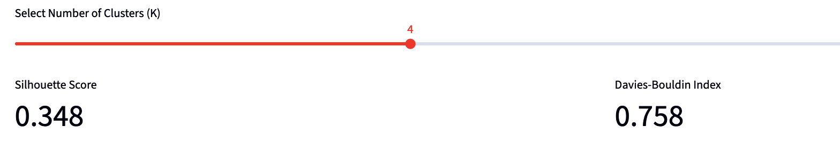
Clustering Models - K-Means Example
14
Silhouette Plot: Shows how well individual points fit within their assigned cluster compared to neighboring clusters. [Describe the plot, e.g., Most clusters show positive scores above the average].
K-Means partitions data into a predefined number (K) of clusters. We explored K=4.
Davies-Bouldin Index: 0.758(Lower score indicates better separation).
Silhouette Score: 0.37 (Indicates [Good/Fair/Poor] cluster separation, closer to 1 is better).
PCA Plot: Provides a 2D view of cluster separation.

Slide 17
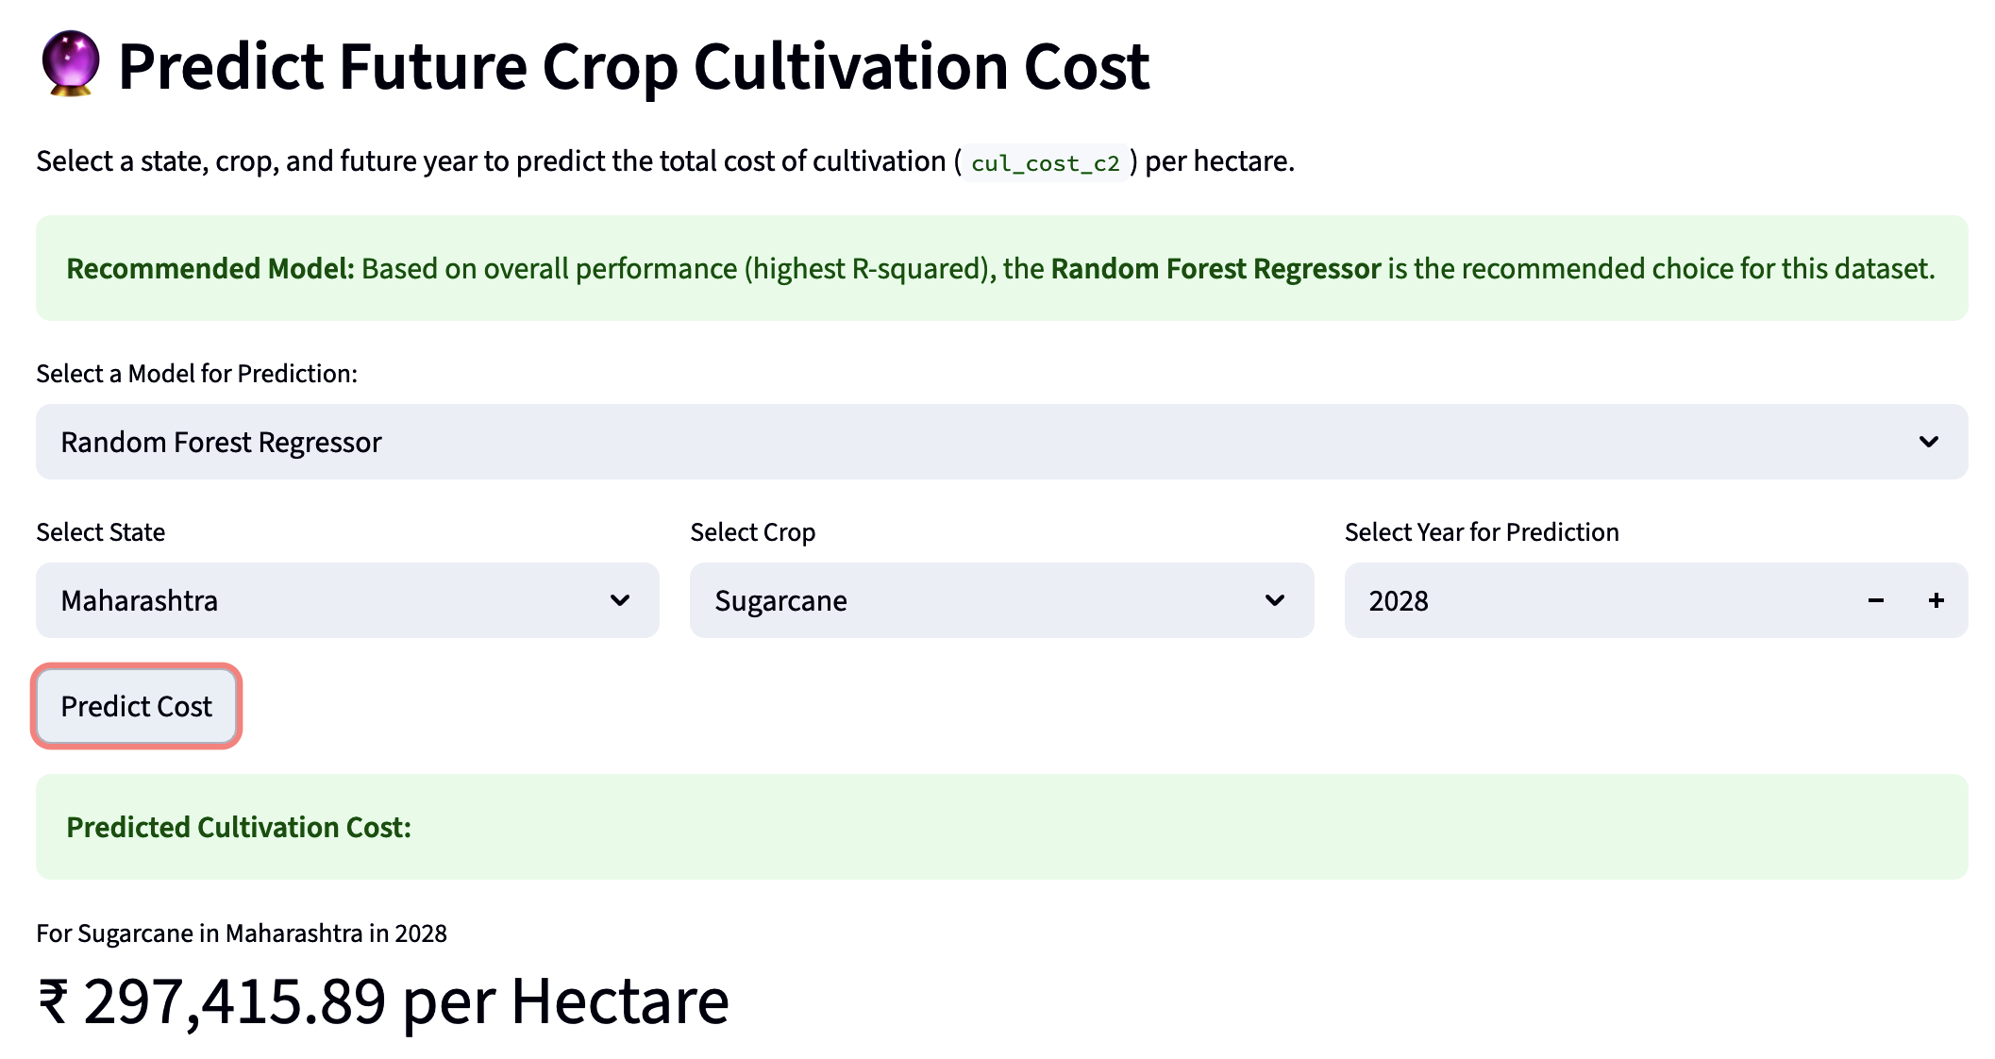
Prediction Tool
15
The dashboard includes a tool to predict future total cultivation cost (cul_cost_c2) per hectare.
Users select the State, Crop, and Target Year.
They can choose a prediction model, with [Best Reg Model Name] recommended based on performance evaluation.
The tool provides an estimated cost, helping with planning and budgeting. (Example: Predicted Cost for Sugarcane in Maharashtra for 2026 using Random Forest Regressor: ₹ 2,97,415 per Hectare).

Slide 18
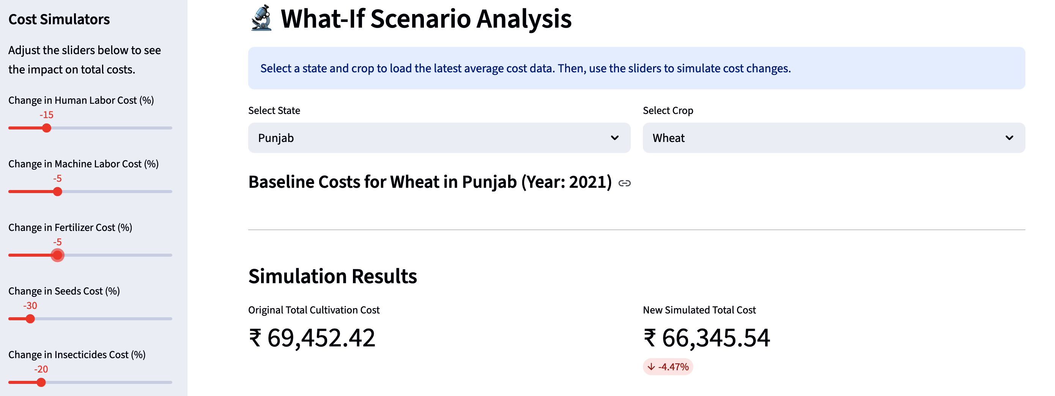
Advanced Feature: What-If Scenario Analysis
16
This tool allows users to simulate the impact of changes in key input costs.
Select a State and Crop to load the latest average cost breakdown.
Use sidebar sliders to adjust costs (e.g., Fertilizer +20%, Labor -10%).
The dashboard instantly recalculates the total cultivation cost and visualizes the change in the cost structure.
Enables users to assess financial sensitivity to market fluctuations or efficiency improvements.

Slide 19
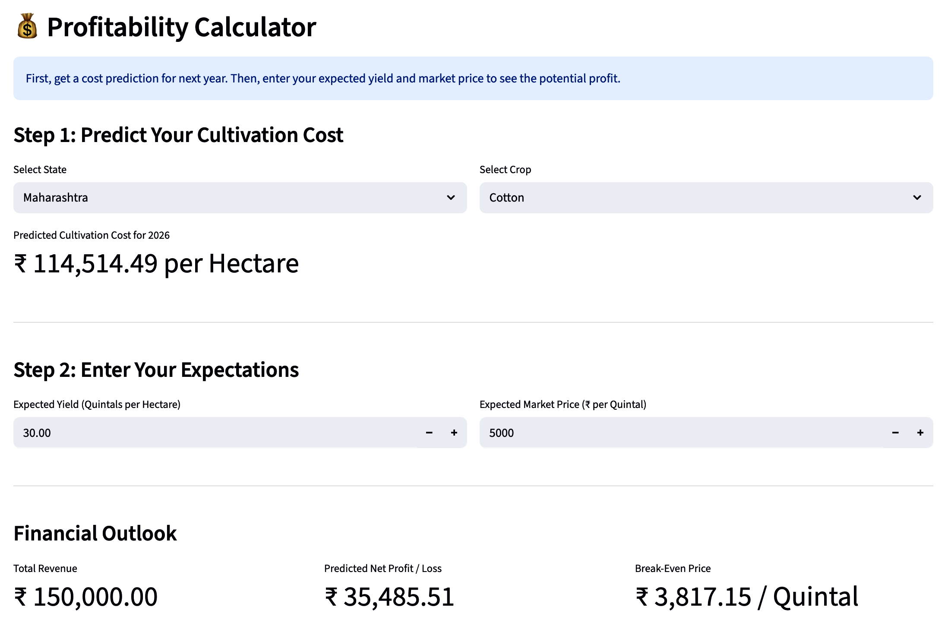
Advanced Feature: Profitability Calculator
17
This tool estimates potential profitability based on cost predictions and user expectations.
Step 1: Predicts the cultivation cost for the selected State, Crop, and next year.
Step 2: User inputs their Expected Yield (Quintals/Hectare) and Expected Market Price (₹/Quintal).
The calculator outputs:
Estimated Total Revenue.
Predicted Net Profit/Loss.
Required Break-Even Price.

Slide 20
Thank You…..

